Slide 1
S2. Economics of Environnement Air pollution
Xavier Timbeau
xavier.timbeau@sciencespo.fr

Slide 2
The air pollution case
Industrial revolution and environmental concern

Slide 5
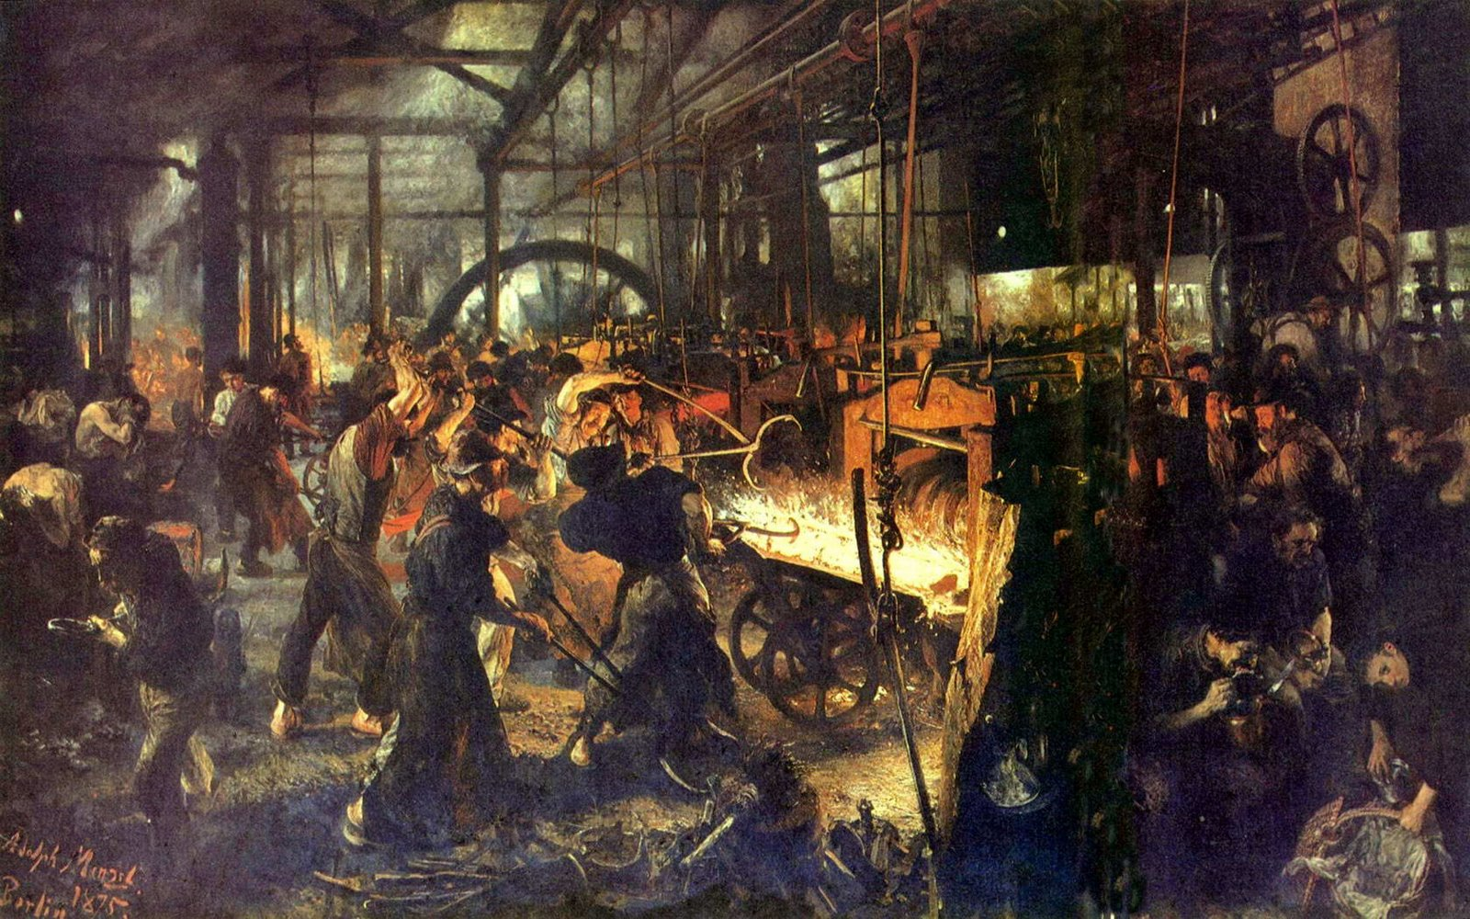
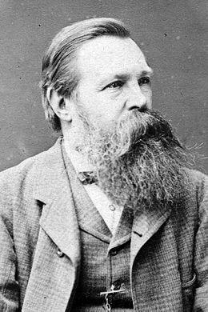
Industrial revolution and environmental concern
From the beginning of the industrial revolution there has been an environmental concern
Anti progress, romantic, naturalist intuition of destruction and distance from true nature of human beings
Effect of health and condition of workers in factories and cities, heavily polluted and with dangerous places to work
Basically the second (accepting progress, claiming a decent life) overrun the first one (see Audier for more on that history)

Slide 6
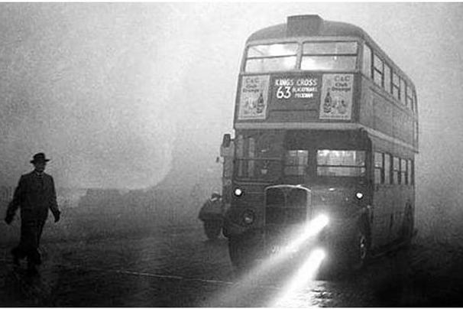
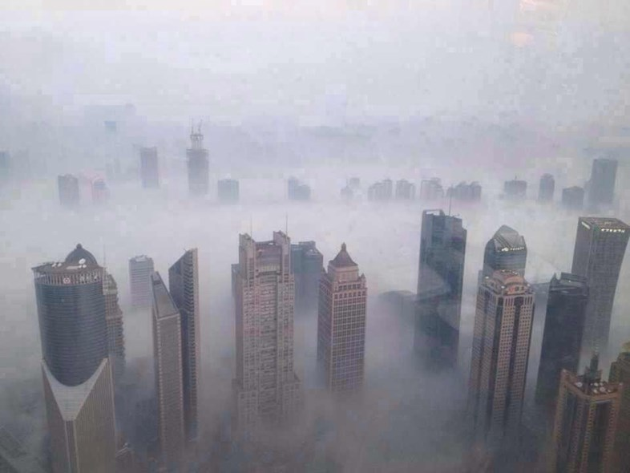
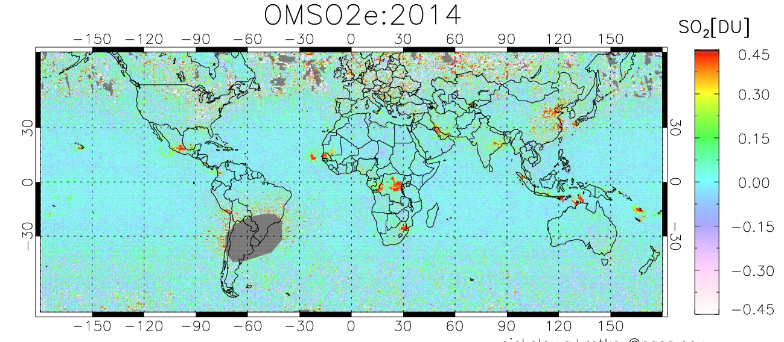
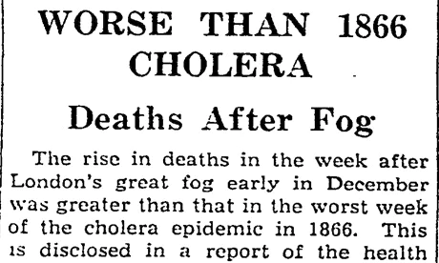
First acts in modern ecology
After industrial revolution and growth in the first part of the XX century, pollution happens to be high
Increasing level of income (especially after WWII) increased attention to pollution : a case for the Coase « theorem » -> Institutional arrangement and contracts will follow the utility and preference emergence. No prior need for markets or full property rights if transaction costs are low enough.
Corollary, transaction costs will determine the institutional solution
UK : Clean air act 1956, solution to the london smog (1952, 4000 deads, 100000 ills) (early concerns starts back in 1853-56, Smoke Abatement Acts (see Sanderson J.B., 1961. "the National Smoke Abatement Society and the Clean Air Act (1956)", Political Studies, 9(3))
US : Noise control Act (1972) ; Clean Air Act (1963, 1967), and in many countries ; Clean Water Acts (1972, 1977, 1987) ; Natural environment Act 1969
Principle : Polluter payer. a justice consideration
Cost of depollution
Gain to depollution
Marginal gain to depollution
Marginal cost of depollution
« Optimal » pollution
Level of pollution
London 1952
Beijing 2015

Slide 7
Clean air and acid rain: a story of spillover

Slide 8
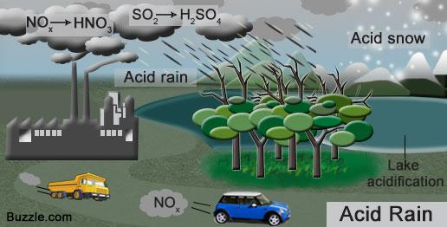
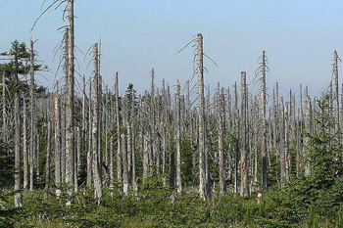
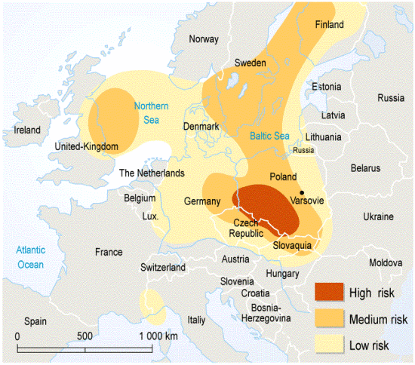
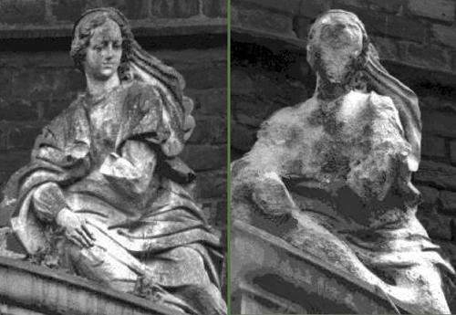
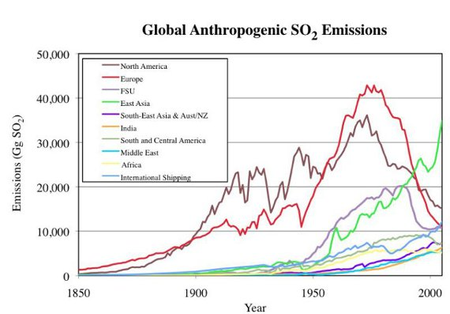
Clean air and acid rain: a story of spillover
Clean Air Acts create a lighter pollution
heavy particules are removed because it is local downfall
Factories are displaced
Lighter pollution means more diffuse
Mixed in clouds, travel long distances, create diffuse downfall and large scale acidification with consequences on water, forests and buildings
Appeared everywhere, but very visible in Germany
Wind circulation of ligther particules
Starting in the 1970’s, a major concern in the 1980’s
Solution: reduce SO2/NO2 emissions
First implementation of cap and trade systems

Slide 9
Clean air and acid rain: a story of spillover

Slide 10
Clean air and acid rain: a story of spillover

Slide 11
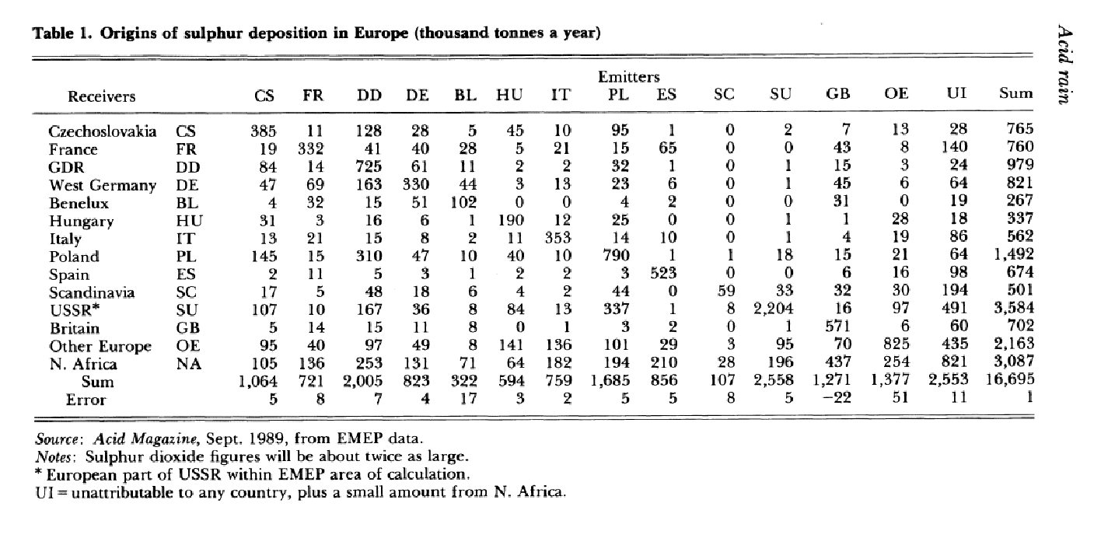
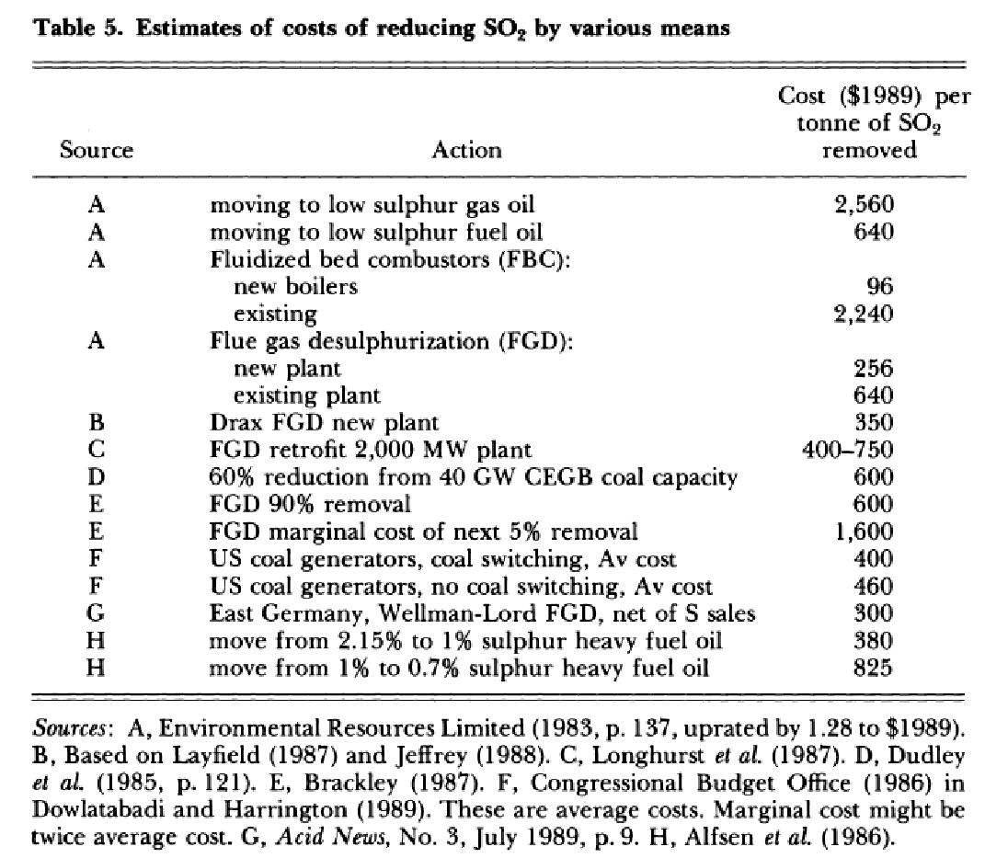
The Acid Rain Solution
Information : EMEP (European Monitoring and Evaluation Programme), under the Convention on Long-range Transboundary Air Pollution (UN Economic Commission for Europe 1979)
Data and modelling, on sources, movement and impacts of air pollution (grid made of 820 square, every 6 hours, measuring mvt of air, pollution in and out)
Efficient cost abatment
Reducing sulfur and NOx emissions has not the same cost nor the same efficiency in reduction of impact (in Europe)
Market based instruments versus Command&Control
International Cooperation
Newbery D. M., H. Sibert et J. Vickers, « Acid Rain », Economic Policy, vol. 5, nº 11, p. 297‑346, 1990.

Slide 12
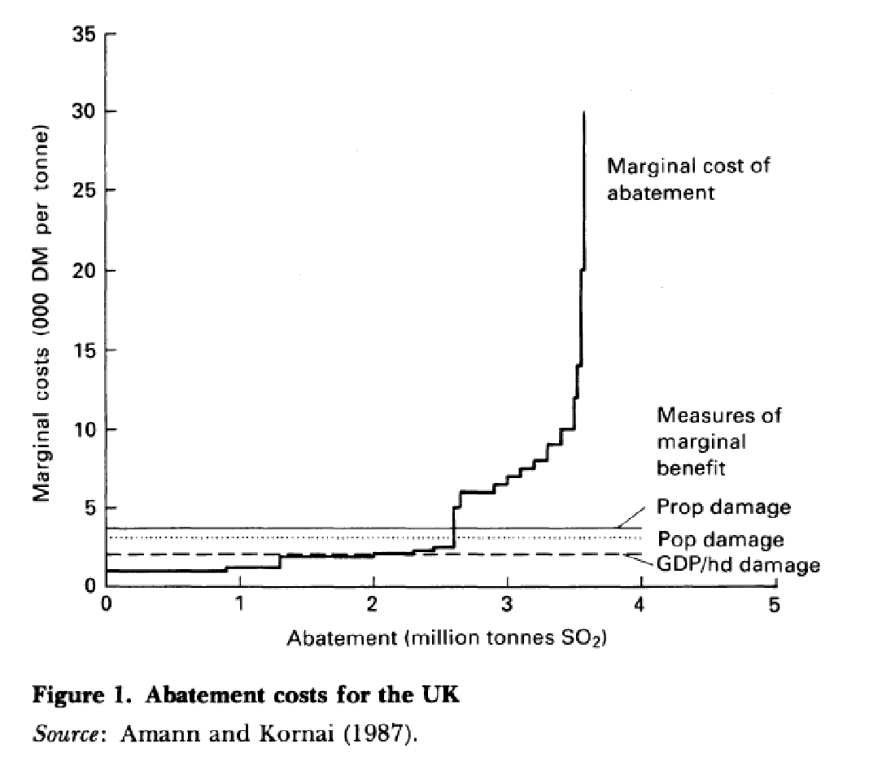
An evaluation of an abatment cost curve

Slide 13
From marginal cost of depollution to marginal abatment curve
Marginal depollution curve and cost central to main stream analysis
Gain to depollution suppose you know the impact of pollution on everything
Air pollution levels depress prices of residential housing, but revealed prices may not contain all the information : so only direct observable impact of pollution on breathing, no evaluation of the increased risk of cancer => optimal pollution is non optimal and defined by limited information
Development may increase awareness of pollution impact and may shift the gain curve upward
Development has an ambiguous effect on the red curve (downward with technical progress, toward the right for increased production)
Cost of depollution
Gain to depollution
Marginal cost of depollution
Marginal gain to depollution
Increased information, increased awareness
Increased production and externalities
New techniques
Level of pollution
Cost of depollution
Cost of depollution
Marginal cost of depollution
Marginal cost of abatement
Marginal gain to abatement
Initial level of pollution
Level of depollution
Or abatement
Level of pollution
The only difference is reverse order for the x-axis

Slide 14
Why a market, why trade emission rights (or rights to pollute) ?
2 arguments and a bonus
Price versus quantity: Sometimes you know better the quantity target, sometimes you have better information on the cost structure. Climate Science gives a quantity target (carbon budget), technical uncertainties, heterogenous capital stock, subsitution effects, consumer behaviour response are complex phenomenom making impossible to assess a priori the marginal cost (and gain) to reach that target. Then it is better to limit quantities and let economic game set the price Weitzman M.L., 1974. "Prices vs. Quantities", The Review of Economic Studies, 41(4), 477.
Tradable rights are more efficient than non tradable (tax or quantity constraints) :
Let’s suppose that the abatement cost curve of UK is steeper than the one of Germany
And it comes with a bonus: Tradable markets allows information revealation, efficiency and let room for free rights Grandfathering allocates right to pollute based on past emissions. No impact on costs in Business as Usual (BAU) (no impact on relative prices as well, reducing effectiveness of internalization of the cost). Still, there is an incentive to reduce pollution through supply only. Good for discussing with industrials.
Marginal cost of abatement
More old tech in UK
Quantity targets for UK and Germany and different abatement cost curves leads to different marginal and mean costs for abatement for UK and Germany.
A common price and tradable rights will allow a transfer from Germany to UK : instead of reducing itself emissions Germany is going to buy reduction in emission (or to buy rights to pollute) to UK. The total cost is going to be lower for Germany and for UK=> it is more efficient and it reaches the same target
UK
Germany
Quantity Target for Germany
Marginal cost for Germany
Common price
Marginal cost for UK
Clean tech
Easy to retrofit
More clean tech
in UK
Quantity Target for UK
Level of depollution
Or abatement
Intermediary tech in Germany

Slide 15
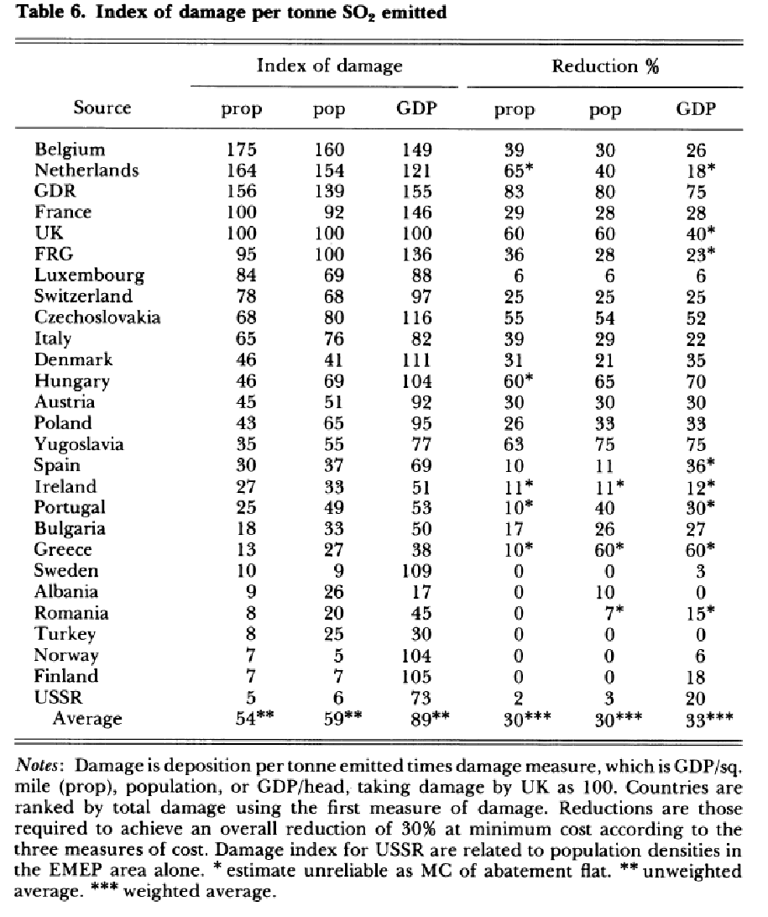
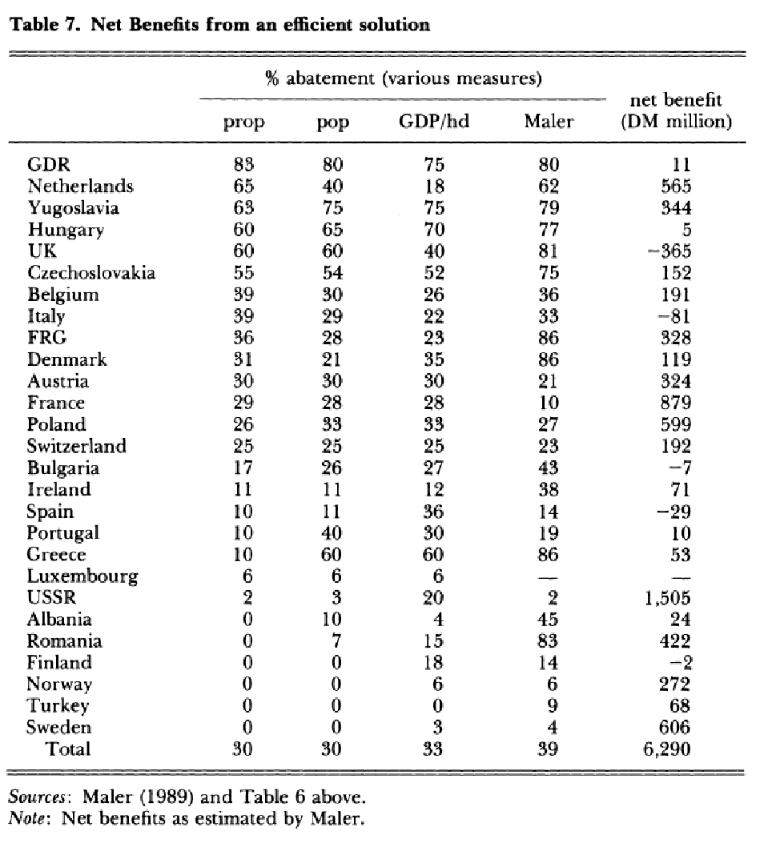
Acid Rain (cont.)

Slide 16
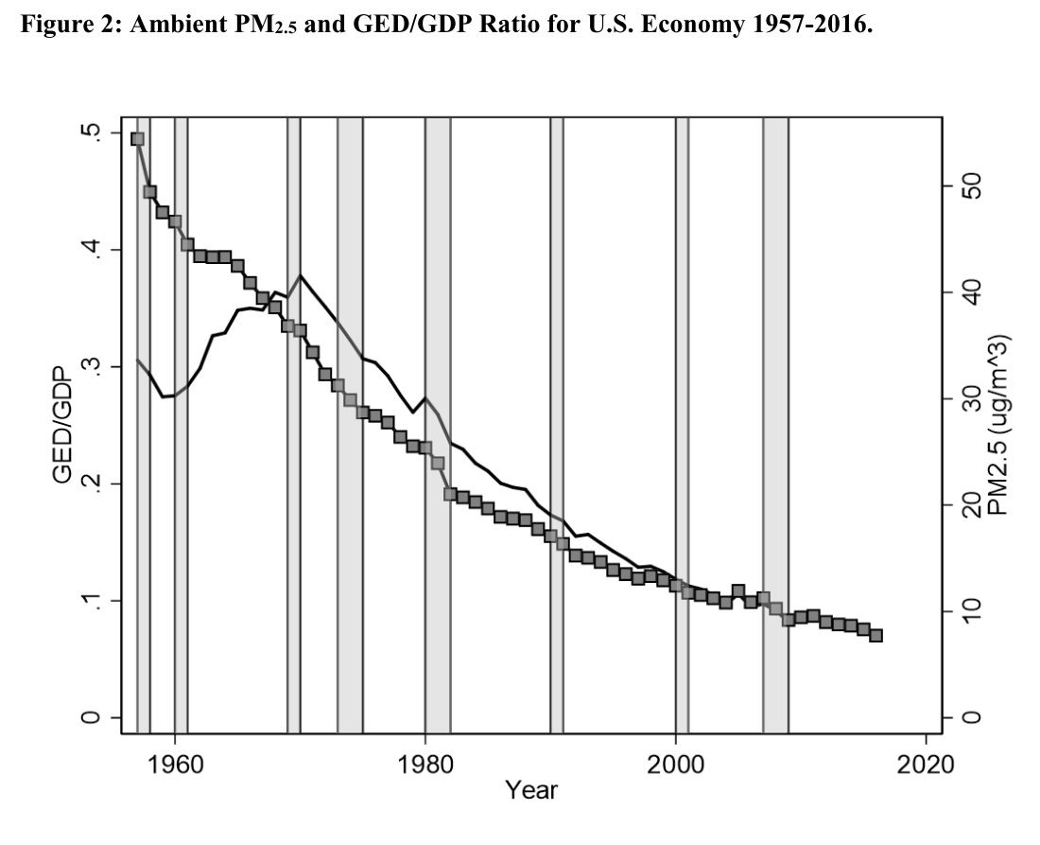
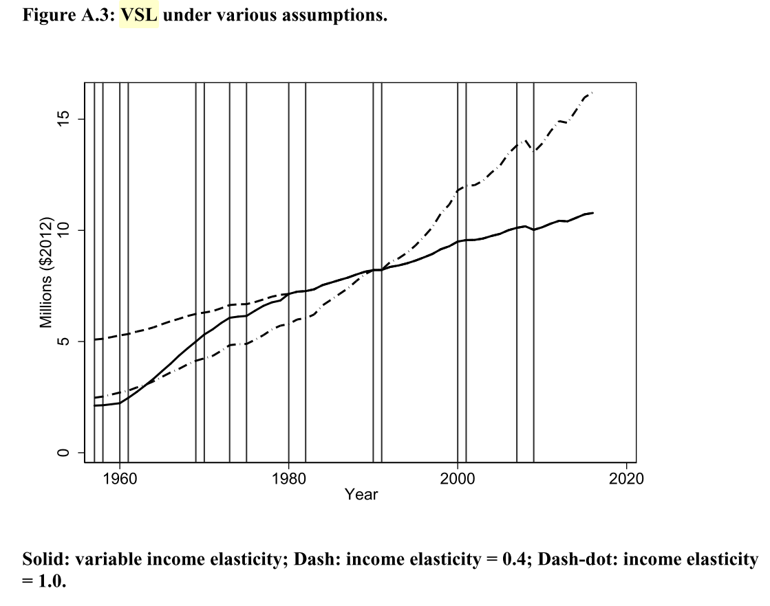
An evaluation for the US
GED stands for Global Economic Damage, based on increase mortality from air pollution (PM2.5) and value of life estimates (Value of Statistical Life)
VSL estimates can be very high
VSL increases with development
No consideration of other pollution
Crude account of coarse localisation of pollution
Through mortality only (and VSL)
Converted as GDP per capital growth
1960-today GDP/h 1.9%/y
Augmented GDP/h 2.4%/y
A peak in the 70’s
Muller, N. Z. (2019). Long-Run Environmental Accounting in the U.S. Economy. NBER Working Paper, No. 25910.

Slide 17
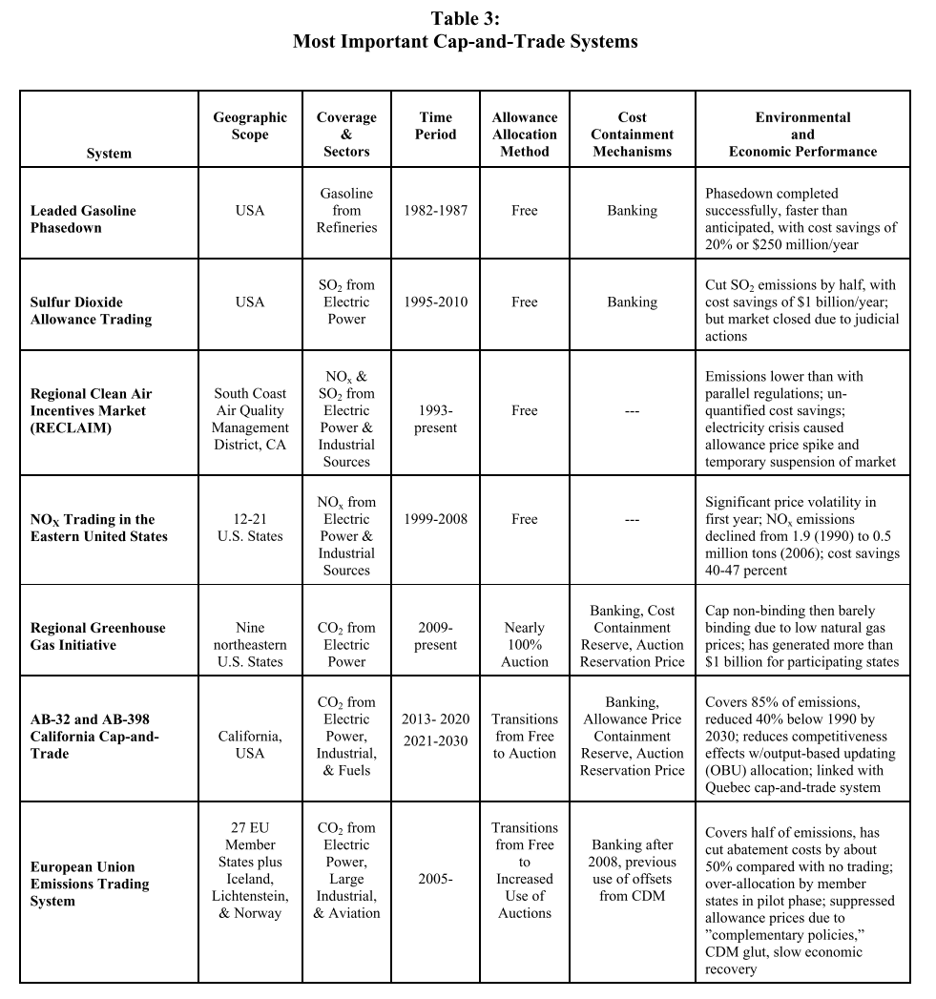
Main implementations of cap-and-trade systems
Stavins, R. (2019). The Future of U.S. Carbon Pricing (NBER working paper No. 25912).
World Bank Group, State and Trends of Carbon Pricing 2019

Slide 18
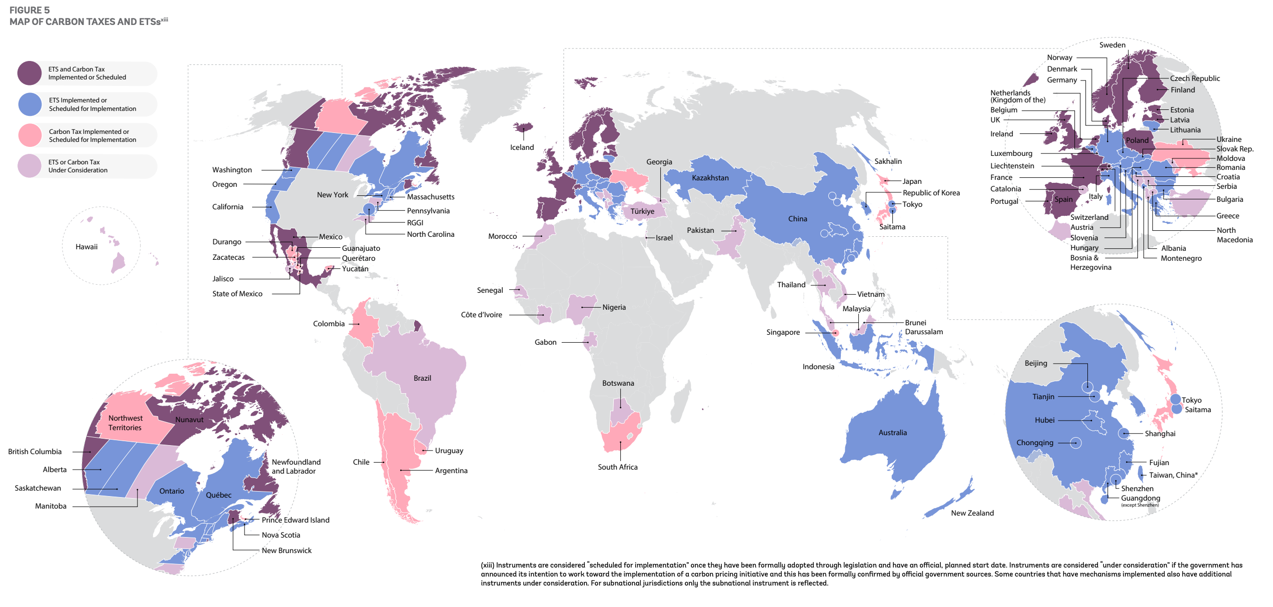
Where and how carbon is priced ?

Slide 19
Carbon pricing in Europe (the ETS)

Slide 20
ETS Carbon pricing
https://ember-climate.org/data/data-tools/carbon-price-viewer/

Slide 21
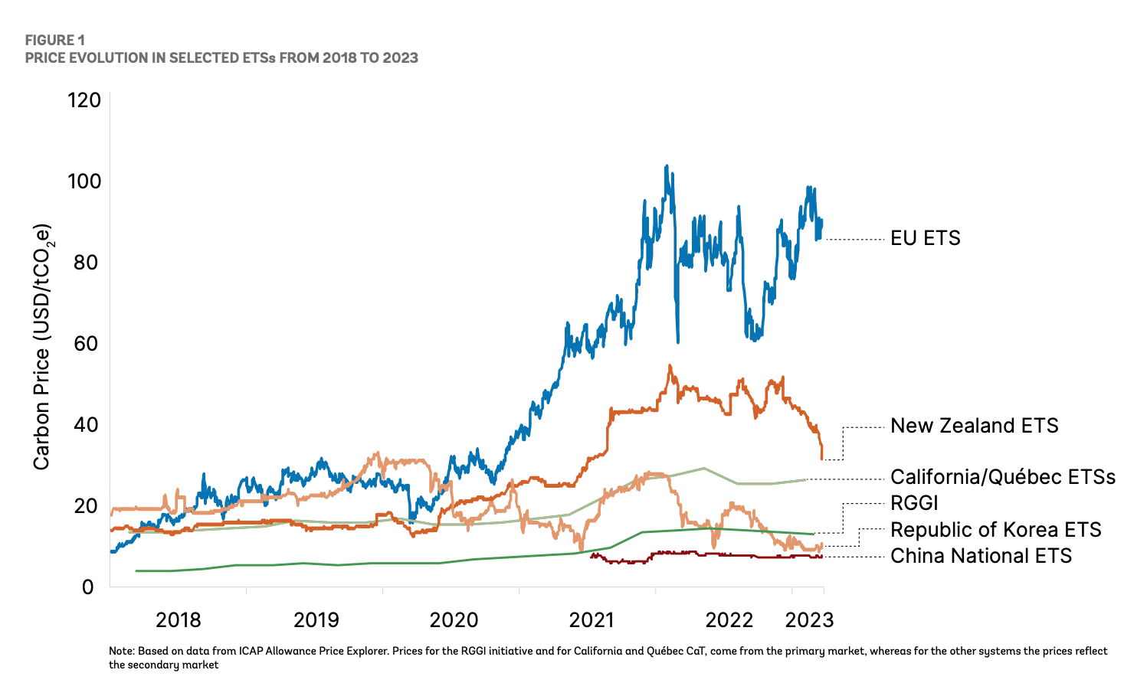
ETS vs RoW

Slide 22
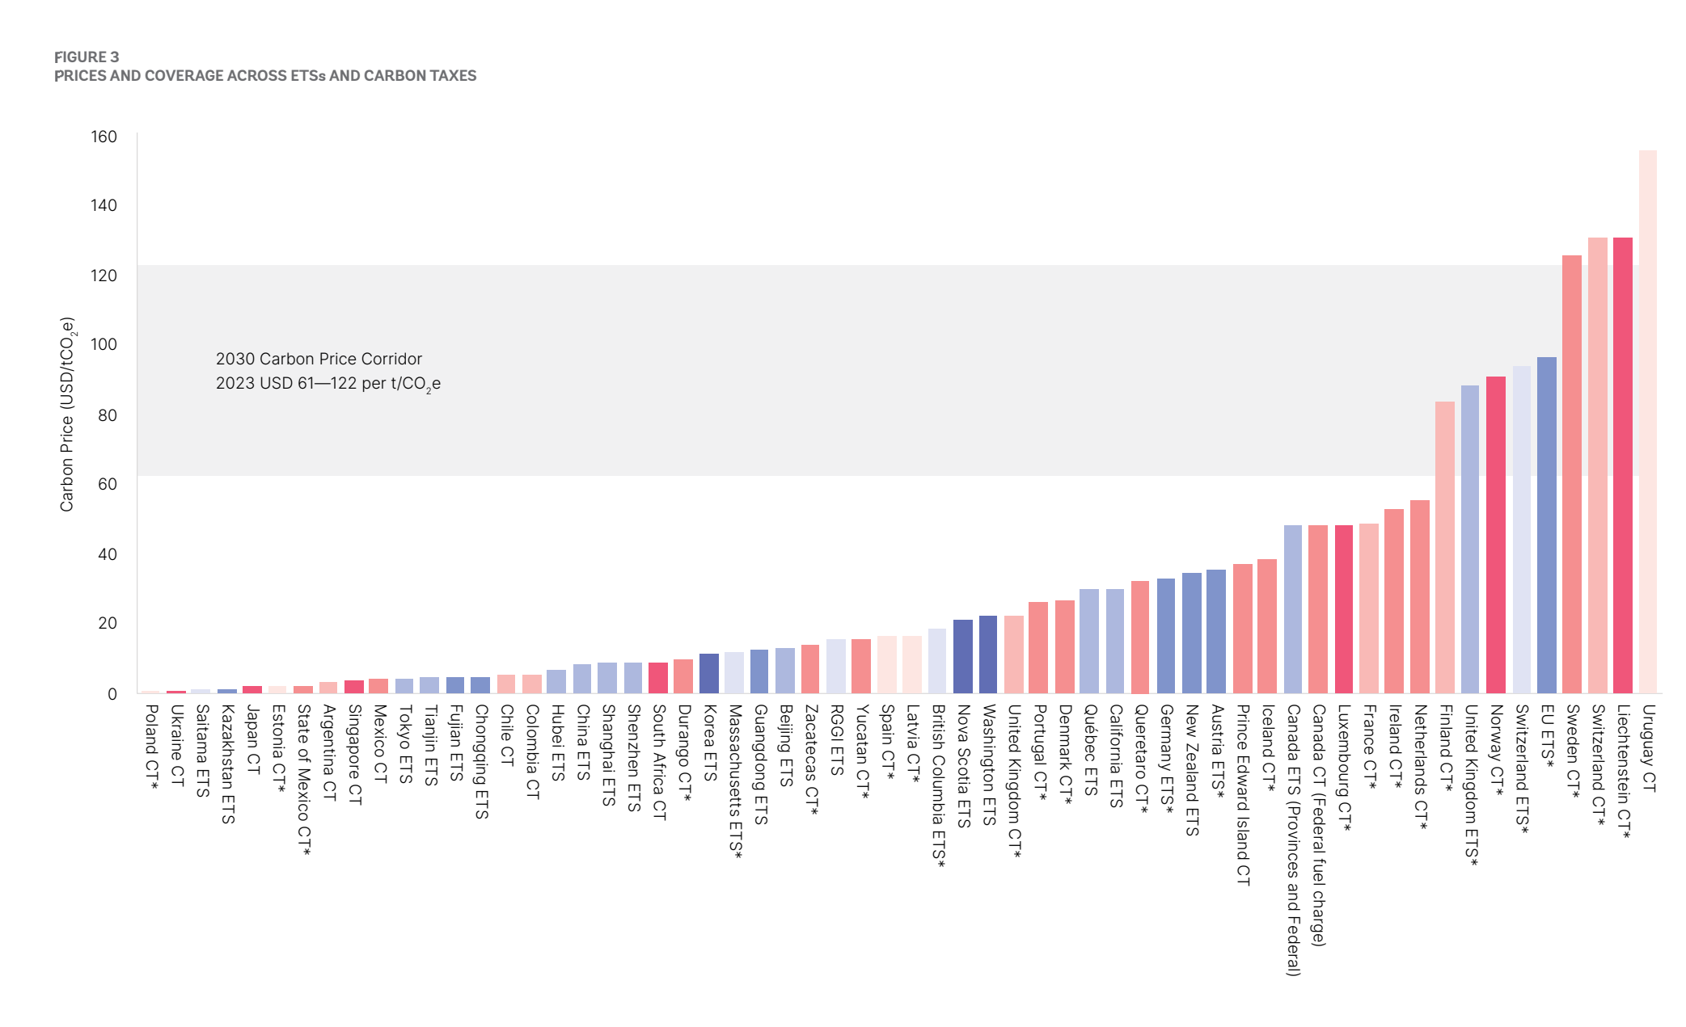
And target

Slide 23
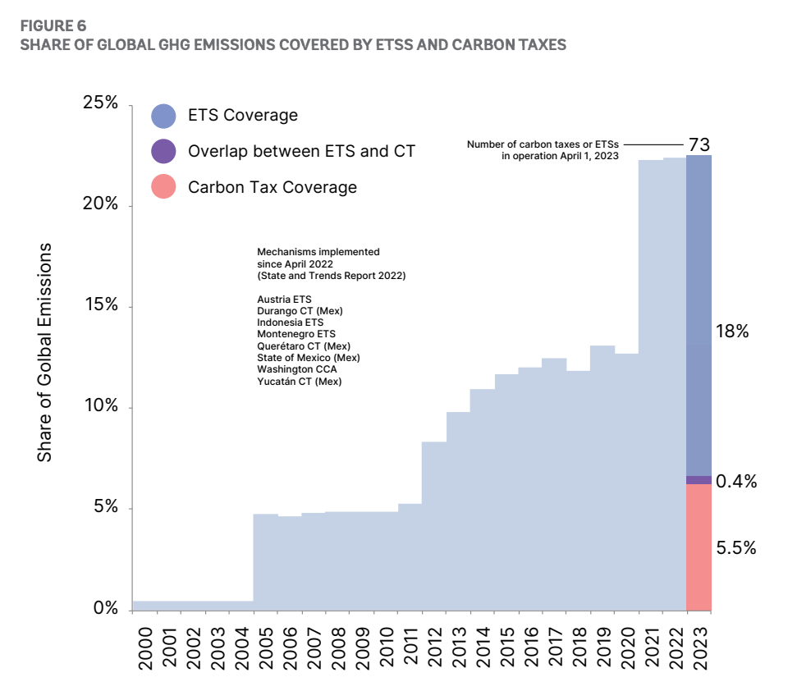
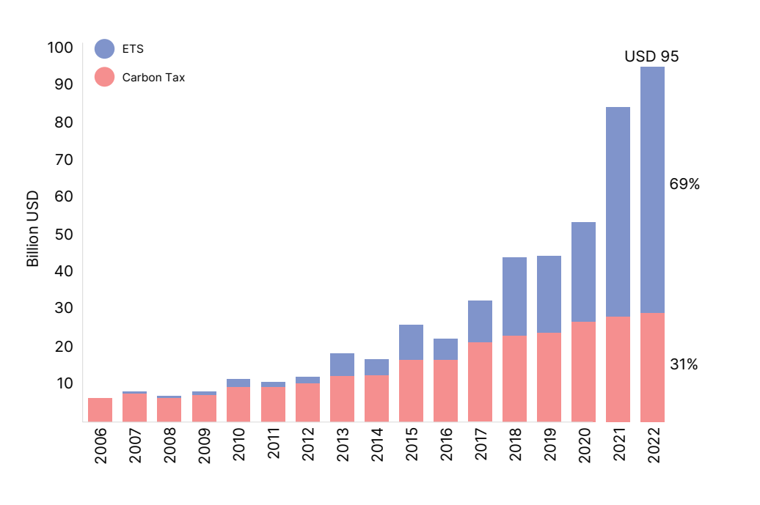
Share of ETS/tax
EU ETS amount to 44% of world carbon revenues for 8% of world emissions
40% of EU emissions are covered by EU ETS
Remains rather low : EU ETS revenue 20 T$ for 42b$ revenu (0.2%)

Slide 24
Quiz time !

Slide 25
Quiz time !

Slide 26
Quiz time !

Slide 27
Quiz time !
A new, zero CO2 emission energy production technology has been invented by Anissa. The marginal production cost of 1 Mwh of electricity with this means of production is 200€.
How much should the carbon emission price (per ton) be for this energy generation to be cheaper than coal production ?

Slide 28
Tax versus Trade-and-cap versus command-and-control
 | Tax | Cap-and-trade | Command-and-control
Cost effectiveness | Yes, under condition If applied to all, with same price | Yes under conditions: If applied to all (high t.c.) No free allowances | No, very different implicit prices Unless cost il low!
Uncertainty of cost uncertainty of quantities | Superior in simple framework, as quantities are a stock Price stability is key to long term decision | Inferior, but quantités are a stock and investment is also Second order depends on comparative slope of marginal cost and marginal benefit Central bank type monitoring of market can stabilze price and mimick tax | Very (too?) flexible, Long term efficiency (through banning)
Governance | Tax legislation, in the hand of finance committee in parliament, not green usually Use of receipts symbolically important (not relevant however) | Specific legislation committees no unanimity needed in the EU | Very specific legislation up to arbitrary and opaque decisions open to lobby influence, hard to commit in the long term very flexible to changes in technology
International agreements | In the UE tax legislation requires unanimity International binding agreements impossible due to principle fiscal sovereignty BTA | international agreement and linkage possible Free allowances can induce carbon leakage (hard to compensate with BTA) | National only except trhough norms applied to imported products
Possibility of capture or fraud Manipulation of outcomes | Strong institutions for tax compliance Principle of equal taxation | Market manipulation possible, but not likely to be an issue Frauds due to different juridictions and linkage Small number of units under trade scheme, caputure by lobbies likely (similar to interbank market) Inter state compensation (hot air) | Impossible to equilibrate pressure Monitoring costs and frauds high
Information, monitoring and compensation | Low costs if taxation is upstream for CO₂ emissions High if monitoring is downstream Compensation is difficult (downstream, high information and monotoring cost) or compensation is lumpsum kind (average compensation, double dividend) | Low for large units, nearly impossible for small ones – taxes and t&c must coexist International markets raise taxation cooperation issues and free rider with another policies interactions Upstream compensation very easy | Very difficult to monitor Compensation at the cost of higher emissions (tradeoff between target and compensation)
Heterogenity | One size fits all Potentially corrected with BTA, with loss of efficiency | Easily reveal social cost Limit extreme pressure on high polluters | Very suited to tailored policies, with efficiency loss unquantifiable

Slide 29
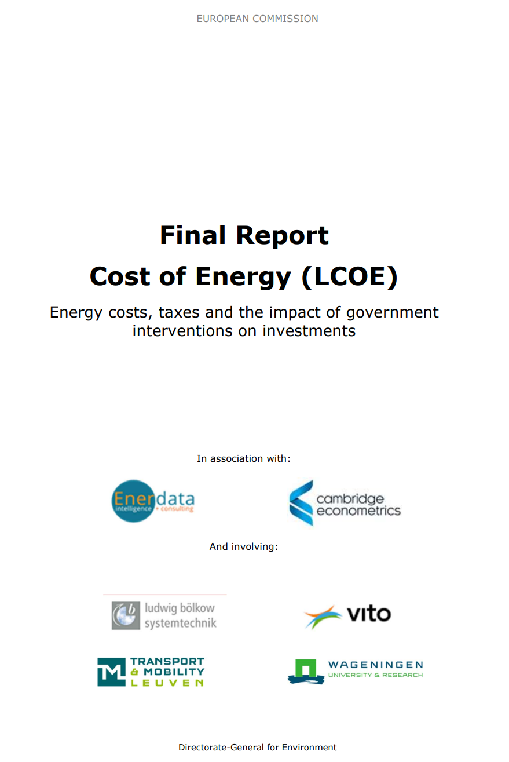
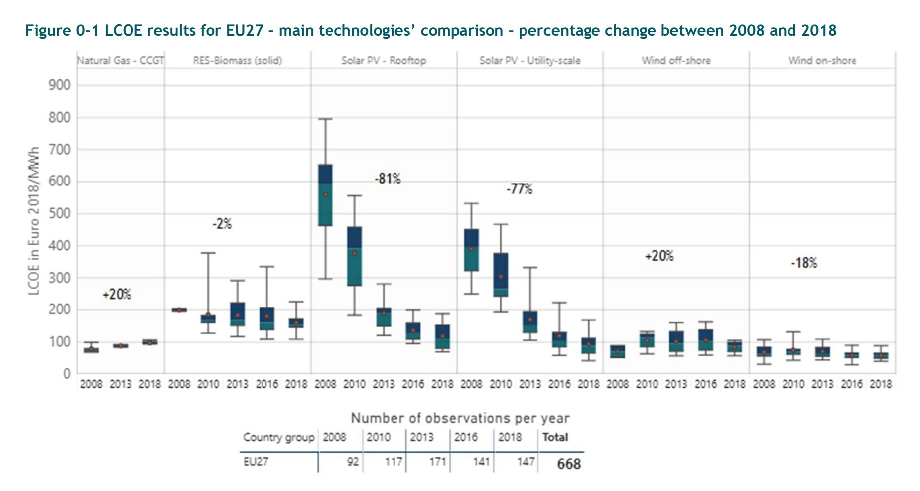
Appendix : LCOE
LCOE stands for Levelized Cost of Energy.
It is the discounted cost overthe life cycle divided by the (discounted) production of electricity.

Slide 30
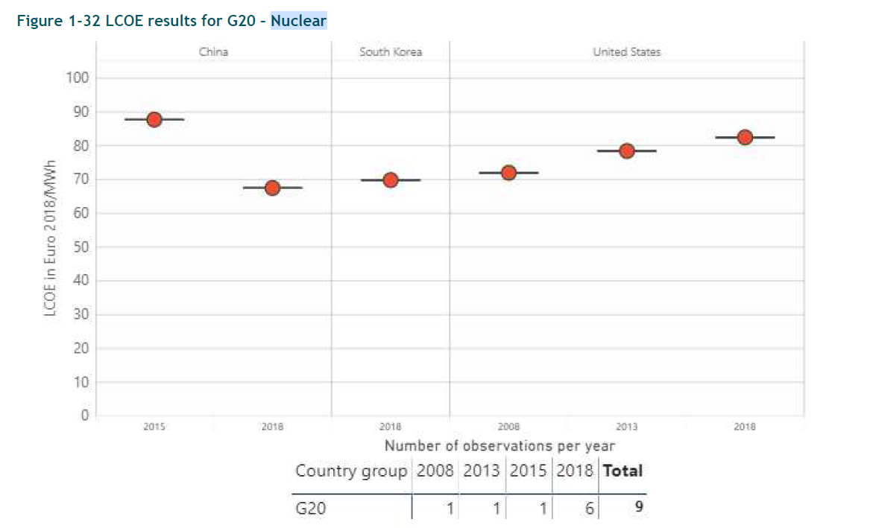
Cost of Nuclear Energy
 | 2018 | 2018-2008
USA | 104 GW
France | 63 GW
China | 45 GW | +36 GW
Japan | 37 GW
Russia | 29 GW | +7.4 GW

Slide 31
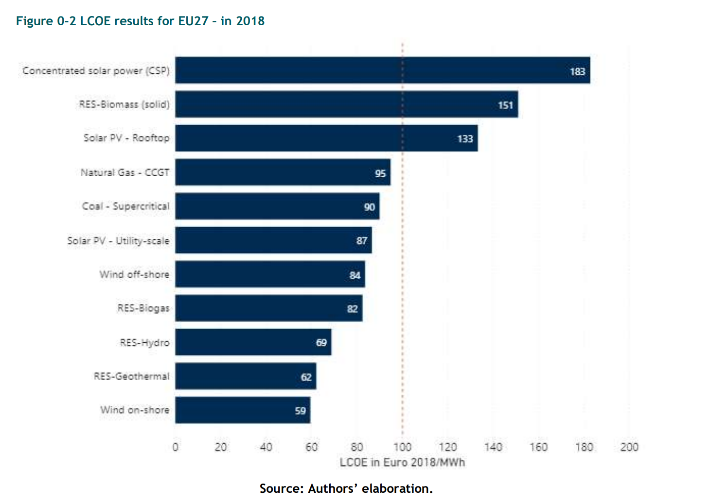
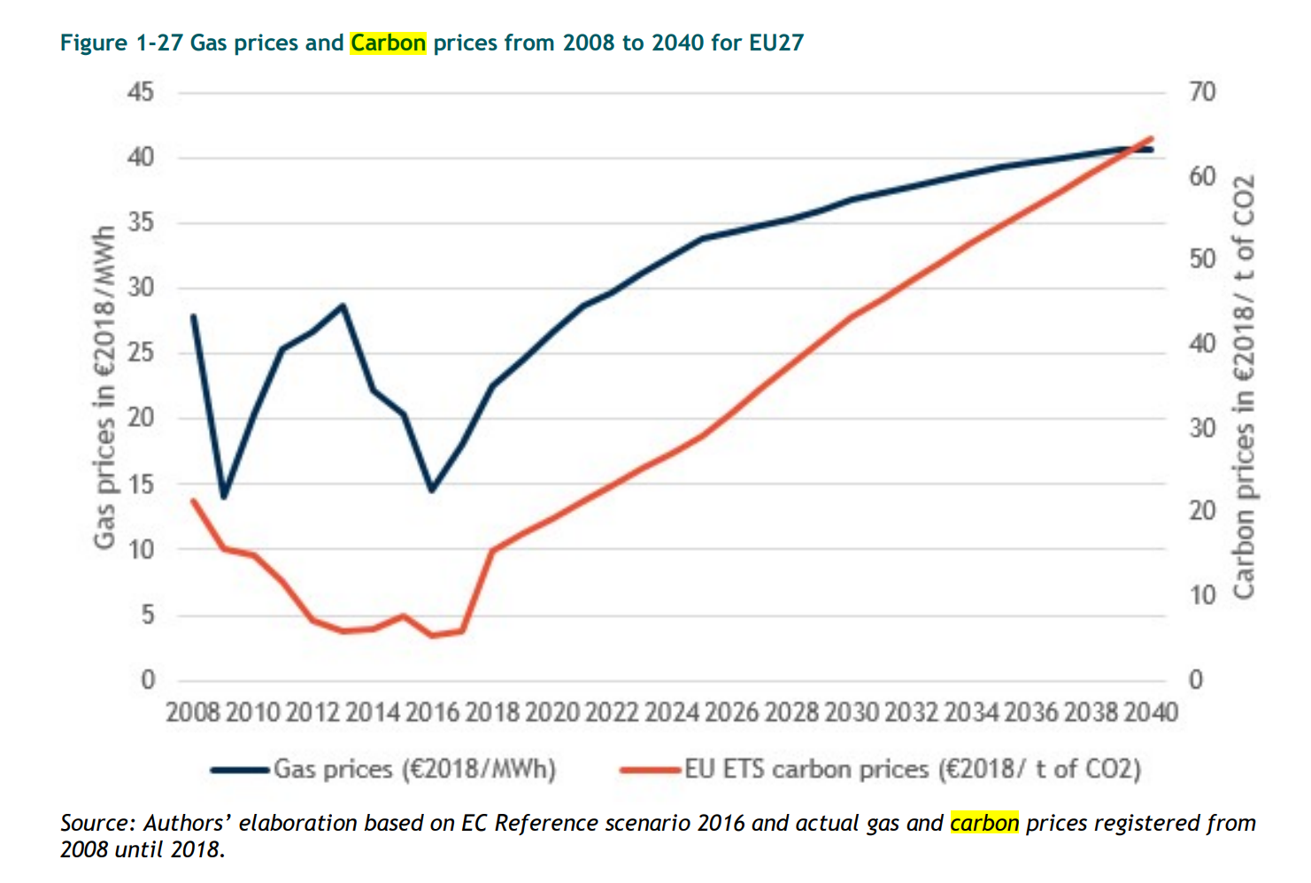
Appendix : LCOE for main energy sources
including carbon price see after

Slide 32
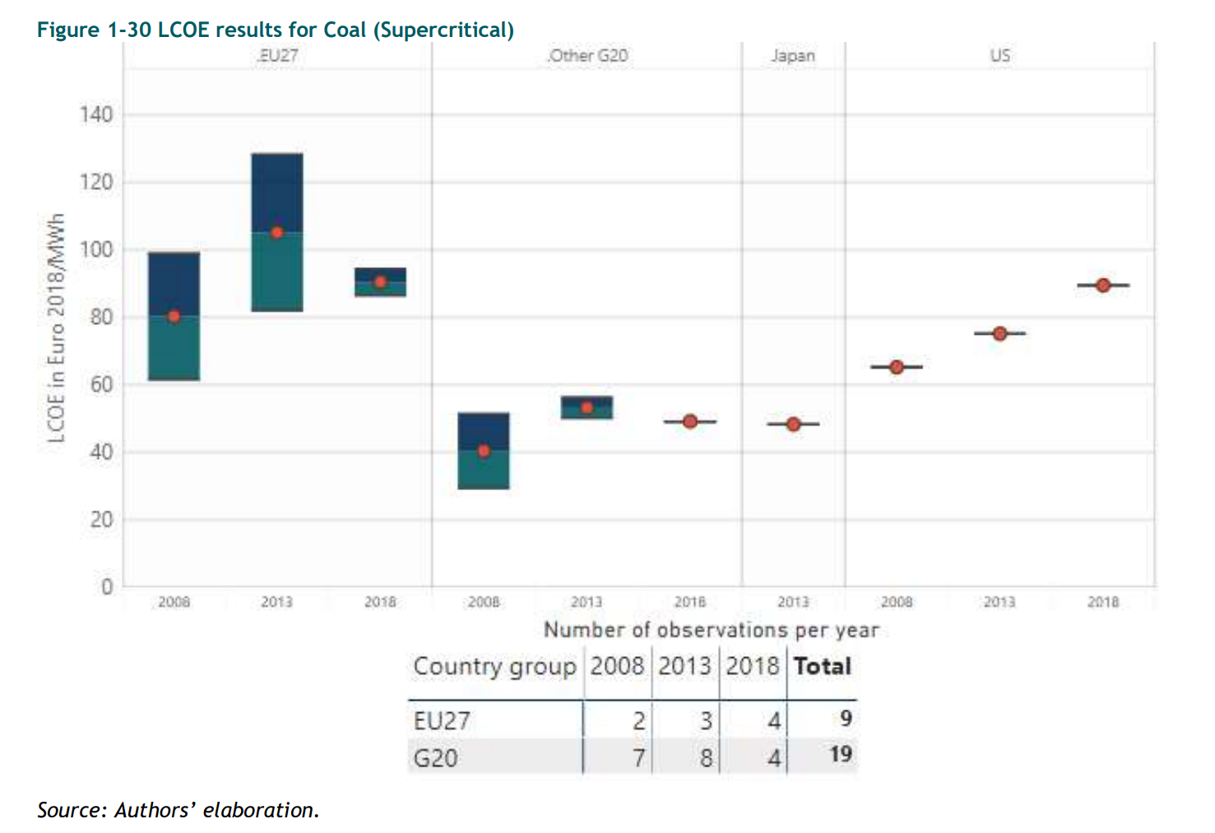
Appendix : Coal case
0€/tCO2 carbon price for non G20

Slide 33
Carbon price hypothesis

